Slide 1

What is Data Science
1.2 Exercises
By Thip Rattanavilay

Slide 2
What is Data Science?

Slide 3
Data science is an inter-disciplinary field that uses scientific methods, processes, algorithms and systems to extract knowledge and insights from many structural and unstructured data.

Slide 4
Data science is related to data mining, machine learning and big data.

Slide 5
Modern data science emerged in tech, from optimizing Google search rankings and LinkedIn recommendations to influencing the headlines Buzzfeed editors run. But it’s poised to transform all sectors, from retail, telecommunications, and agriculture to health, trucking, and the penal system. Yet the terms “data science” and “data scientist” aren’t always easily understood, and are used to describe a wide range of data-related work.
How did modern data Science emerge?

Slide 6
History Of Data Science
The term “data science” has been traced back to 1974, when Peter Naur proposed it as an alternative name for computer science. In 1996, the International Federation of Classification Societies became the first conference to specifically feature data science as a topic. However, the definition was still in flux.

Slide 7
What data scientists do?
We now know how data science works, at least in the tech industry. First, data scientists lay a solid data foundation in order to perform robust analytics. Then they use online experiments, among other methods, to achieve sustainable growth. Finally, they build machine learning pipelines and personalized data products to better understand their business and customers and to make better decisions. In other words, in tech, data science is about infrastructure, testing, machine learning for decision making, and data products.

Slide 8
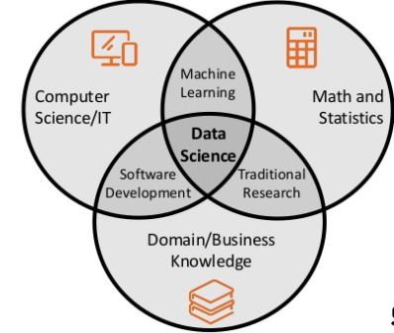


Slide 9
Data Science Process
Questions
Data
Exploratory Data Analysis
Formal Modelling
Interpretation
Communication
Result

Slide 10



Data Science Tools

Slide 11

Data Science: Case Study

Slide 12

Conclusion
Data scientists today draw largely from extensions of the “analyst” of years past trained in traditional disciplines. As data science becomes an integral part of many industries and enriches research and development, there will be an increased demand for more holistic and more nuanced data science roles.

Slide 13
References
Data science. (2020, August 28). Retrieved September 06, 2020, from https://en.wikipedia.org/wiki/Data_science
Bowne-Anderson, H. (2018, September 18). What Data Scientists Really Do, According to 35 Data Scientists. Retrieved September 06, 2020, from https://hbr.org/2018/08/what-data-scientists-really-do-according-to-35-data-scientists
Press, G. (2014, October 15). A Very Short History Of Data Science. Retrieved September 06, 2020, from https://www.forbes.com/sites/gilpress/2013/05/28/a-very-short-history-of-data-science/
Abhishek SharmaHe is a data science aficionado. (2020, March 22). How to Use Google Colab for Deep Learning and Machine Learning. Retrieved September 06, 2020, from https://www.analyticsvidhya.com/blog/2020/03/google-colab-machine-learning-deep-learning/
Project Jupyter. (n.d.). Retrieved September 06, 2020, from https://jupyter.org/

